Slide 1
ECOMMERCE WEBSITE

Slide 2
PROBLEM STATEMENT
A problem statement is a clear and concise description of an issue or challenge that needs to be addressed.
It is a fundamental part of problem-solving and project development.
A well-crafted problem statement helps to define the scope of a problem, understand its significance, and guide efforts to find solutions

Slide 3
TECHNICAL STACK
Front End
HTML
CSS
Bootstrap
Back End
JavaScript
Java
My Sql

Slide 4
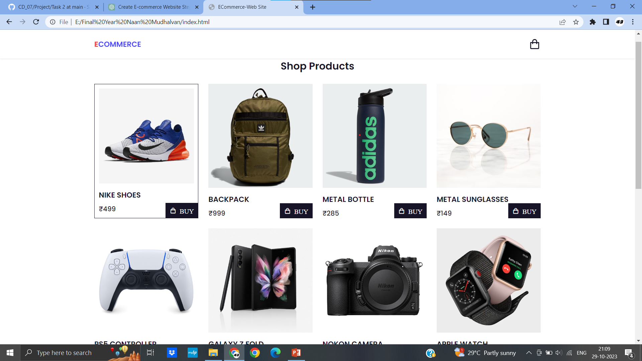
USER INTERFACE

Slide 5
REPOSITORY LINK https://github.com/Sathish-43/CD_07

